Slide 1
COVID-19
To intubate or not to intubate!
That is (sort of) the question
Capstone 2
Sam Holmstrom

Slide 2
Introduction
Pre-existing conditions and certain other risk factors may predict COVID severity
Although some clinics have adjusted, new hotspots will require quick response
Ongoing spread will continue to strain the of resources, especially in ill-equipped areas
While intubation-ventilator protocols remain an important intervention, shortage may force medical staff to decide to triage some patients that may need ventilators
Although in many cases this may be a ”clearer” decision, it is complex to determine
Question: Can we use machine learning to better anticipate what COVID patients may require intubation?

Slide 3

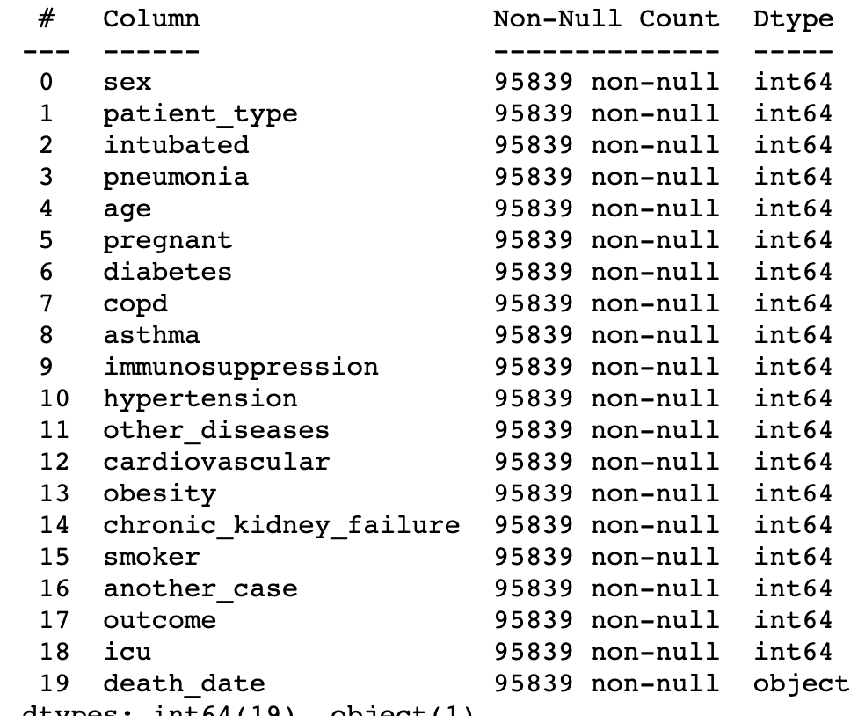
COVID-19 Case Dataset from Mexico
Recent dataset from Kaggle:
Mexican government has collected
A fairly large dataset of COVID-19
positive patients that includes
health information and whether they got intubated or not

Slide 4
COVID-19 Case Dataset from Mexico
Descriptors
 | 1 | 2 | 3 | 97
sex | male | female |  | N/A
diabetes | yes | no |  | N/A
other_diseases | yes | no |  | N/A
smoker | yes | no |  | N/A
patient_type | outpatient | inpatient |  | N/A
copd | yes | no |  | N/A
cardiovascular | yes | no |  | N/A
another_case | yes | no |  | N/A
intubated | yes | no |  | N/A
asthma | yes | no |  | N/A
obesity | yes | no |  | N/A
outcome | INDRE | LESP y | LAVE | N/A
pneumonia | yes | no |  | N/A
immunosuppression | yes | no |  | N/A
chronic_kidney_failure | yes | no |  | N/A
hypertension | yes | no |  | N/A

Slide 5
Goal
To develop a model that can predict whether a patient will need intubation based on
patient features included in dataset, even what company test was used for diagnosis:
The abililty to predict COVID intubation cases will inform administers estimate current and future demand for ventilators on an ongoing basis
If medical staff are faced with close to call decision on which patient(s) will have
Priority for a ventilator, the model can give information in what feature combinations
for a patient led to higher probability to be intubated
Will not require
a ventilator?
Profile Information of
admitted COVID-19]
patient
(age, sex, health history etc….)
Predictive
Model
Will require
a ventilator?

Slide 6
Breakdown of the COVID positive patient dataset
All COVID-19 Positive patient
~95,000
Inpatient
Outpatient
Non-ICU
~73,000
~22,000
ICU
~2000

Slide 7
Breakdown of the COVID positive patient dataset
All COVID-19 Positive patient
~95,000
Inpatient
Outpatient
Non-ICU
~73,000
~22,000
ICU
~2000
Since attempting to predict probability a COVID patient gets intubated
based on features, only inpatients are relevant here

Slide 8
~22,000
~2000
All Inpatient
(non-ICU and ICU)
ICU patients
Very imbalanced

Slide 9
~22,000
~2000
All Inpatient
(non-ICU and ICU)
ICU patients
Very imbalanced

Slide 10
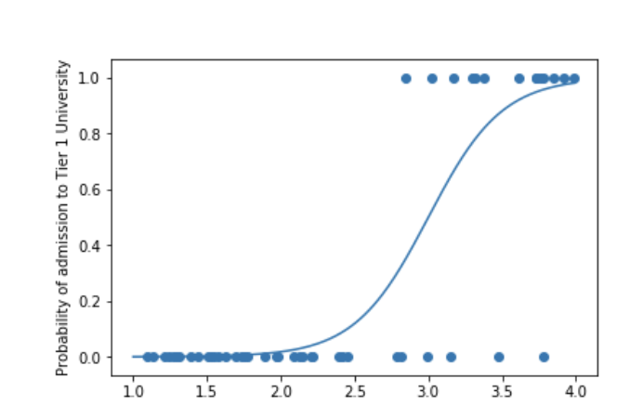
Logistic Regression (for all inpatients)
Has the ability to provide a probability of belonging to a class
Can adjust decision threshold to change balance between recall and precision scores
Step 1. Model optimization (Gridsearch)
Step 2. Optimize decision threshold
Include ICU as a feature
Threshold at 0.5
Threshold at 0.2
‘C': 0.1,
'penalty': 'l2’,
'solver': 'lbfgs’
'max_iter': 10000,
Regularization parameters
Predict
intubate
Do NOT include ICU as a feature
Probability of intubation
Probability of intubation
Predict
intubate
'C': 0.001, ‘
'penalty': 'l2’,
'solver': 'liblinear’
max_iter': 10000,
Predict
not to
intubate
Regularization parameters
no
intubation
age
age
Adapted from “Thinkful Day 24 lecture 1, Data Science Immersion Course”
by Mike Swirsky

Slide 11
Decision Boundary
Maximum recall macro average: Balances optimal recall of both true cases of intubation and non-intubation in test set
Training set
Include ICU as a feature
Do NOT include ICU as a feature
F
Recall (macro average)
Recall (macro average)
Decision Threshold
Decision Threshold

Slide 12
Logistic Regression:
Test set
Include ICU as a feature
Do NOT include ICU as a feature
‘C': 0.1, 'max_iter': 10000, 'penalty': 'l2', 'solver': 'lbfgs'
'C': 0.001, 'max_iter': 10000, 'penalty': 'l2', 'solver': 'liblinear'
Test macro average recall score is 0.7377779940158946
Train macro average recall score is 0.7507360131224436
Test macro average recall score is 0.5292703725352943
Train macro average recall score is 0.5139371690218073

Slide 13
Logistic Regression:
Test set
5-fold cross validation of full dataset
gave consistent scores
Include ICU as a feature
Do NOT include ICU as a feature
‘C': 0.1, 'max_iter': 10000, 'penalty': 'l2', 'solver': 'lbfgs'
'C': 0.001, 'max_iter': 10000, 'penalty': 'l2', 'solver': 'liblinear'
Test macro average recall score is 0.7377779940158946
Train macro average recall score is 0.7507360131224436
Test macro average recall score is 0.5292703725352943
Train macro average recall score is 0.5139371690218073

Slide 14
ICU as single feature:
ICU as a feature alone provides about the same predictive power regardless of other features
Without other features
Test macro average recall score is 0.7195850494630278
With other features
Test macro average recall score is 0.7377779940158946

Slide 15
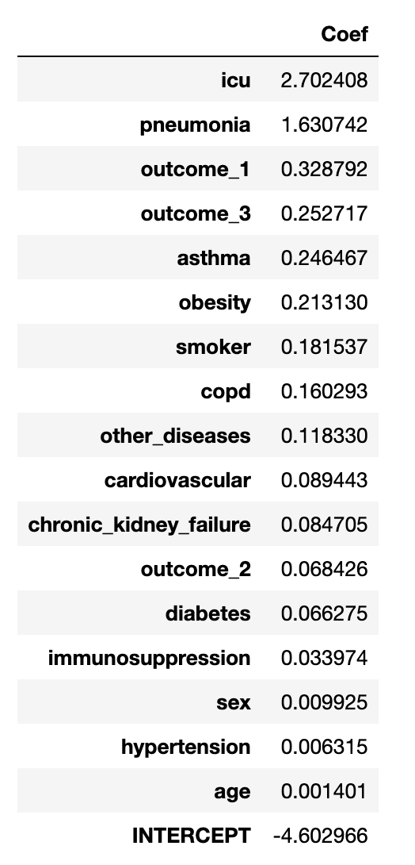
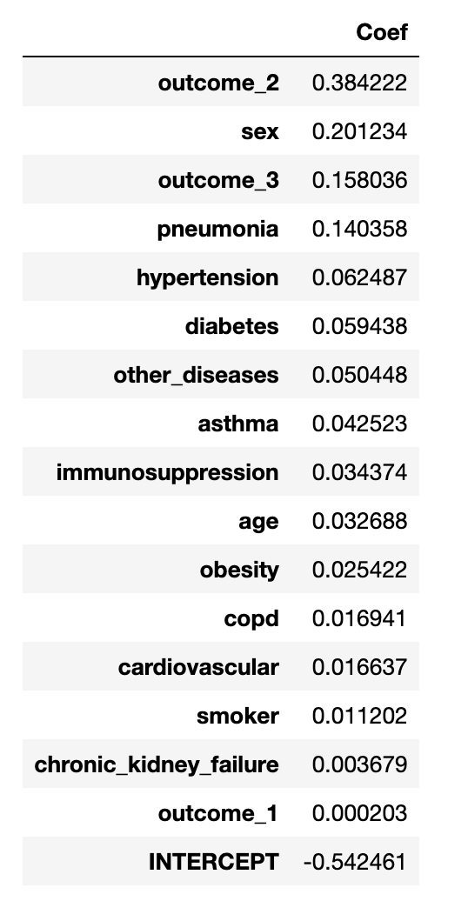
Feature importance rank
Training set
Include ICU as a feature
Do NOT include ICU as a feature
F
Test macro average recall score is 0.7377779940158946
Test macro average recall score is 0.5292703725352943
ICU and pneumonia
drive the predictions
The strongest
Company 2
COVID test becomes
The strongest
Feature!
Does this mean that
There may be come
Negatives in group?

Slide 16
~22,000
~2000
All Inpatient
(non-ICU and ICU)
ICU patients
Very imbalanced

Slide 17
Decision Boundary
Maximum recall macro average: Balances optimal recall of both true cases of intubation and non-intubation in test set
Training set
ICU only
F
Recall (macro average)
Decision Threshold

Slide 18
Logistic Regression:
Test set
ICU only
'C': 0.01, 'max_iter': 10000, 'penalty': 'l2', 'solver': 'lbfgs'
Test macro average recall score is 0.6230094466936573 Train macro average recall score is 0.6123506927854754
These are scores without pneumonia
Test macro average recall score is 0.5847023159396385 Train macro average recall score is 0.5830453361360521

Slide 19
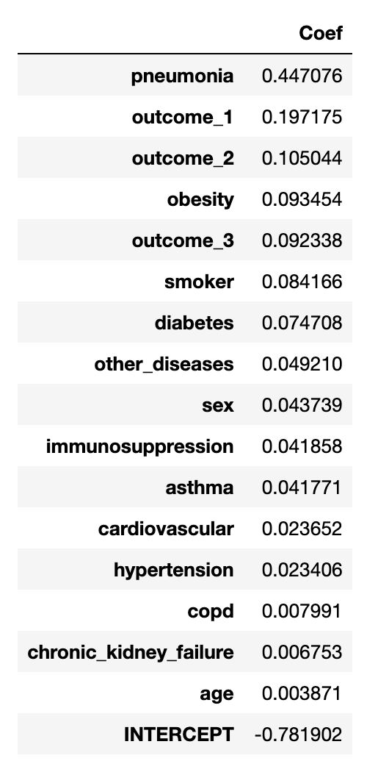
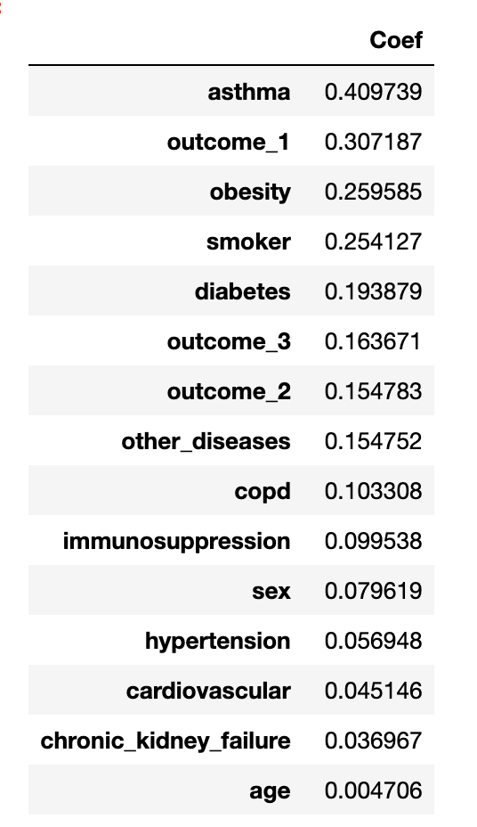
Feature importance rank
These are scores without pneumonia
These are scores without pneumonia
Test macro average recall score is 0.6230094466936573 Train macro average recall score is 0.6123506927854754
Test macro average recall score is 0.5847023159396385 Train macro average recall score is 0.5830453361360521
Company 1 and 2 instead of 3
COVID test become
Leading features!
Pneumonia
Is highest, not surprising
Age is lowest--interesting
Asthma replaces
pneumonia
Age is still lowest

Slide 20
Other classification models:
All features, buy looking at ICU admitted patient poplulation only
RandomForestClassifier
(max_depth=7, max_features=3, n_estimators=1000)
Test macro average recall score is 0.6002496489311906 Train macro average recall score is 0.7035378219099533
KNeighborsClassifier
(n_neighbors=5, weights='distance', algorithm='ball_tree', leaf_size=10)
Test macro average recall score is 0.5493279539932684
Train macro average recall score is 0.9188376231179213
SVMClassifier
{'C': 10, 'kernel': 'linear'}
Test macro average recall score is 0.5905980429307002
Train macro average recall score is 0.6056894533148678

Slide 21
Conclusions
*Without knowning ICU status, current input features do not really inform the model to about how many intubated cases may arise in the hospital
*When ICU status is known, model might provide some information about whether that patient
will be more likely to be intubated:
Might help decide patient priority for ventilator use if all other clinical features are equal.

Slide 22
Thank you

